Slide 1
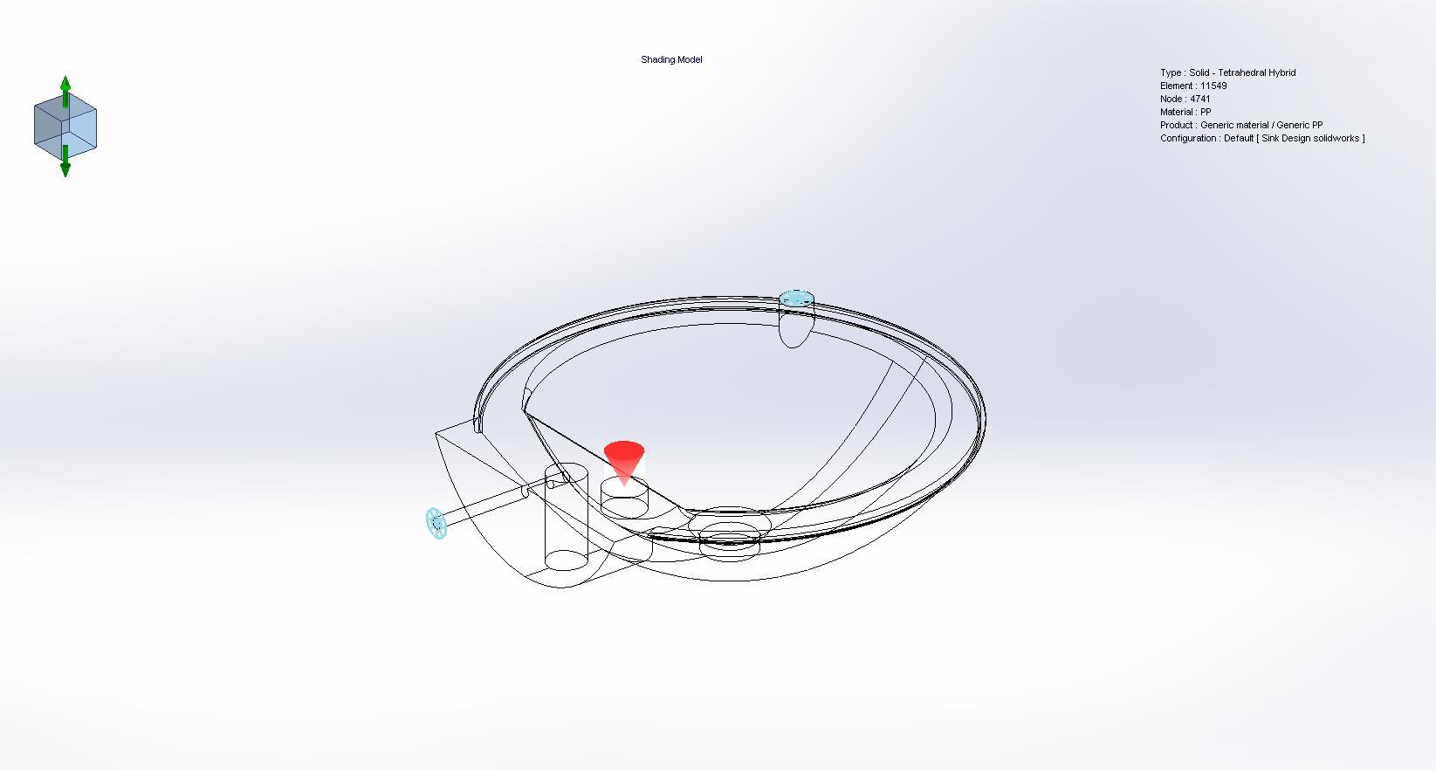
INJECTION MOLDING FLOW ANALYSIS OF SINK MOLD
Date
Created by
Department
Organization
Logo
URL
<Study_Image/>

Slide 2
Description

Slide 3
Machine Information
Number of Processors | 8
Maximum number of threads | 8
Number of available threads | 8
Software type | Windows 10
SOLIDWORKS Plastics version | SOLIDWORKS Plastics Premium 2025 SP1.0

Slide 4
Study Characteristics
Part name | Sink Design solidworks
Configuration | Default
Study Name | FLOW ANALYSIS
Injection Process | Single Material
Number of Injection Units | 1
Analysis (Mesh) Procedure | Solid
Simulation Type | Fill + Pack

Slide 5
Injection Unit 1 Settings
Material | Generic material / Generic PP
Filling Time | Automatic
Melt Temperature | 230 °C
Mold temperature | 50 °C
Injection Pressure Limit | 100 MPa
Fill/Pack Switch Point (% Filled Volume) | 100 %
Temperature Criteria for Short Shots | 135°C
Mold Temperature Profile | Off
Mold-Melt Heat Transfer Coefficient | Off
Pressure Holding Time | Automatic
Pure Cooling Time | 80 sec

Slide 6
Polymer Properties
Trade Name and Grade: Generic material / Generic PP
Ejection Temperature | 95°C
Transition Temperature | 135°C
Young Modulus | E1: 1350 MPa, E2: 1350 MPa
Poisson's Ratio | v12: 0.4, v23: 0.4
Max. Shear Rate | 100000 1/s
Max. Shear Stress | 0.25 MPa
Fiber Percentage | Not Available

Slide 7
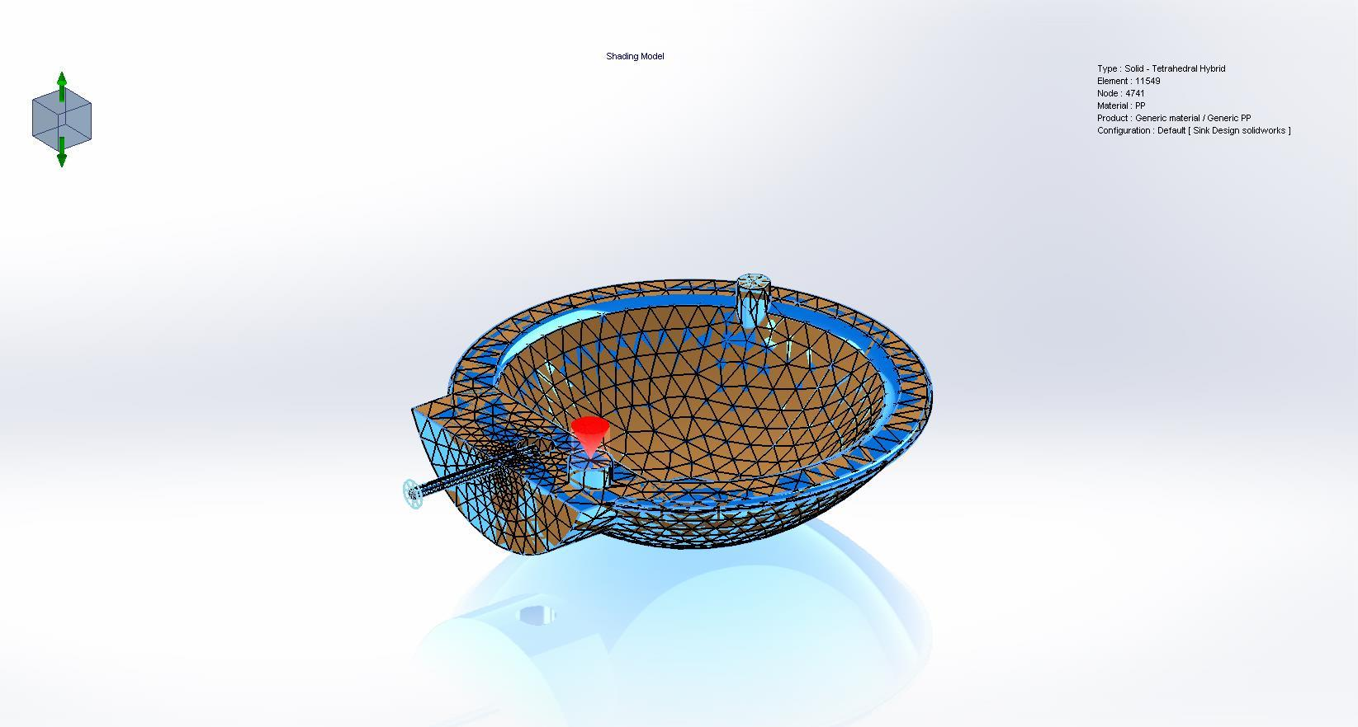
Domains
Name | Image
Combine2 (-Cavity-)

Slide 8
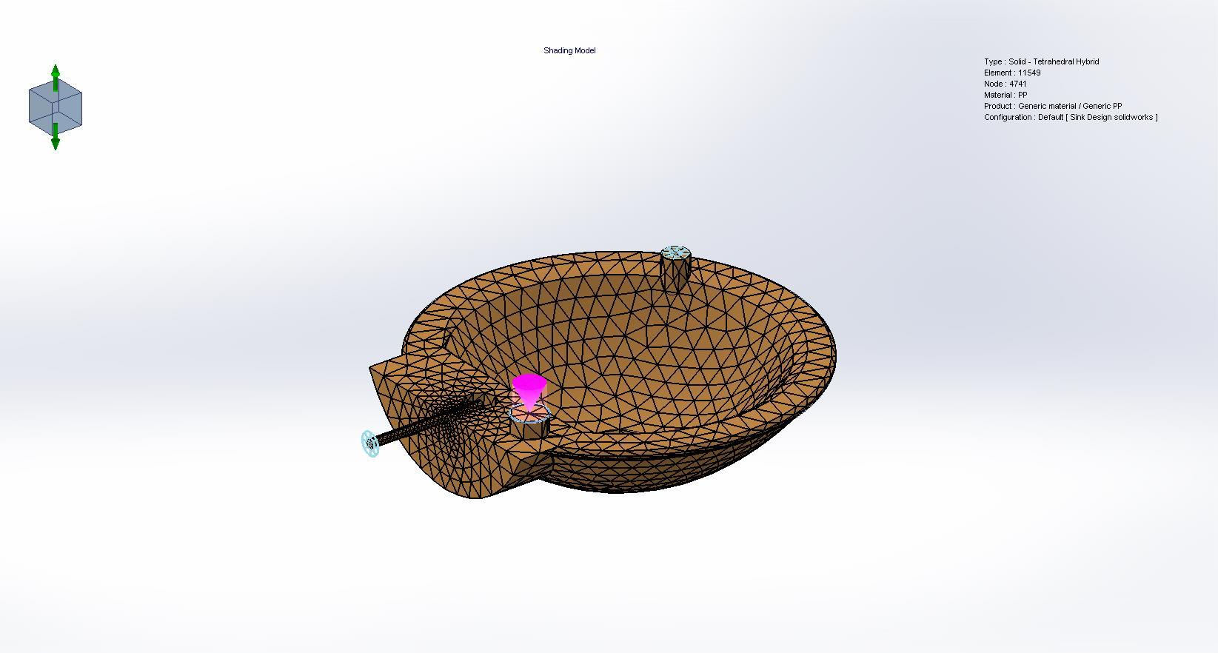
Boundary Conditions
Name | Image | Details
Injection Location-1 |  | Entity name

Slide 9
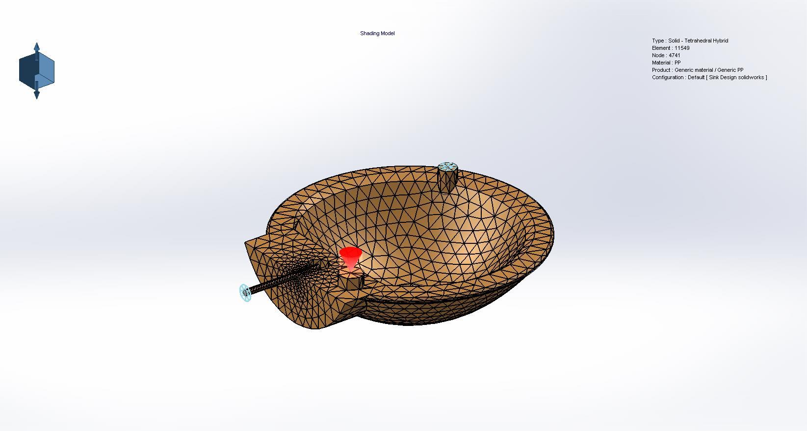
Boundary Conditions
Name | Image | Details
Clamp Force-1 |  | Clamp Force Direction
 |  | Excluded Region

Slide 10
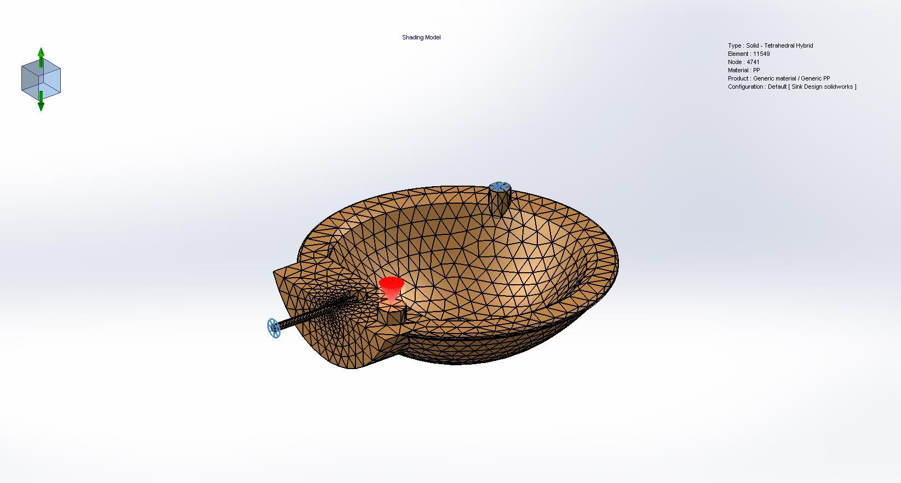
Boundary Conditions
Name | Image | Details
Air Vents-1 |  | Entity name

Slide 11
Global Parameters
General
Clamp Force Limit: 100 Tonne
Ambient Temperature: 30 °C

Slide 12
Global Parameters
Fill-Pack
Gravity Downward Direction for fill: -Y
Venting Analysis: Off
Solver Type: AMG
Volume of Fluid Algorithm: CICSAM

Slide 13
Global Parameters
Warp
Gravity Downward Direction for warp: -Y
Solver Type: AMG

Slide 14
Global Parameters
Cool
Mold Open Time: 5 sec
Specify control based on <Ejection Temperature /Cooling Time >: Ejection Temperature
Solver Type: AMG
Analysis Method: FEM-Linear

Slide 15
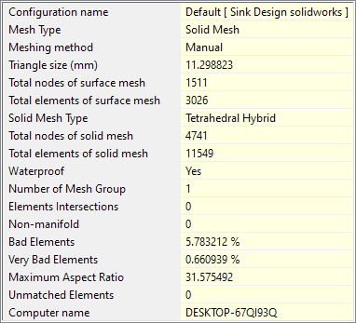
Mesh Details
<Image_Mesh_Details/>

Slide 16
Results Summary
Fill Results
<Results_Summary/>
Clamp Force | 2.4426 Tonne
X-dir. Clamping Force | 1.1999 Tonne
Y-dir. Clamping Force | 2.4426 Tonne
Z-dir. Clamping Force | 1.2252 Tonne
Required injection pressure | 8.3592 Mpa
Max. real temperature | 230.1567 °C
Max. bulk temperature | 230.1565 °C
Max. shear stress | 0.2409 Mpa
Max. shear rate | 2883.3990 1/sec

Slide 17
Results Summary
Fill Results
<Results_Summary/>
CPU Time | 717.59 sec
Cycle Time | 115.16 sec
1. Filling Time | 10.16 sec
2. Total Time in Pack Stage | 100.00 sec
a). Pressure Holding Time | 20.27 sec
b). Pure Cooling Time | 79.73 sec
3. Mold Open Time | 5.00 sec

Slide 18
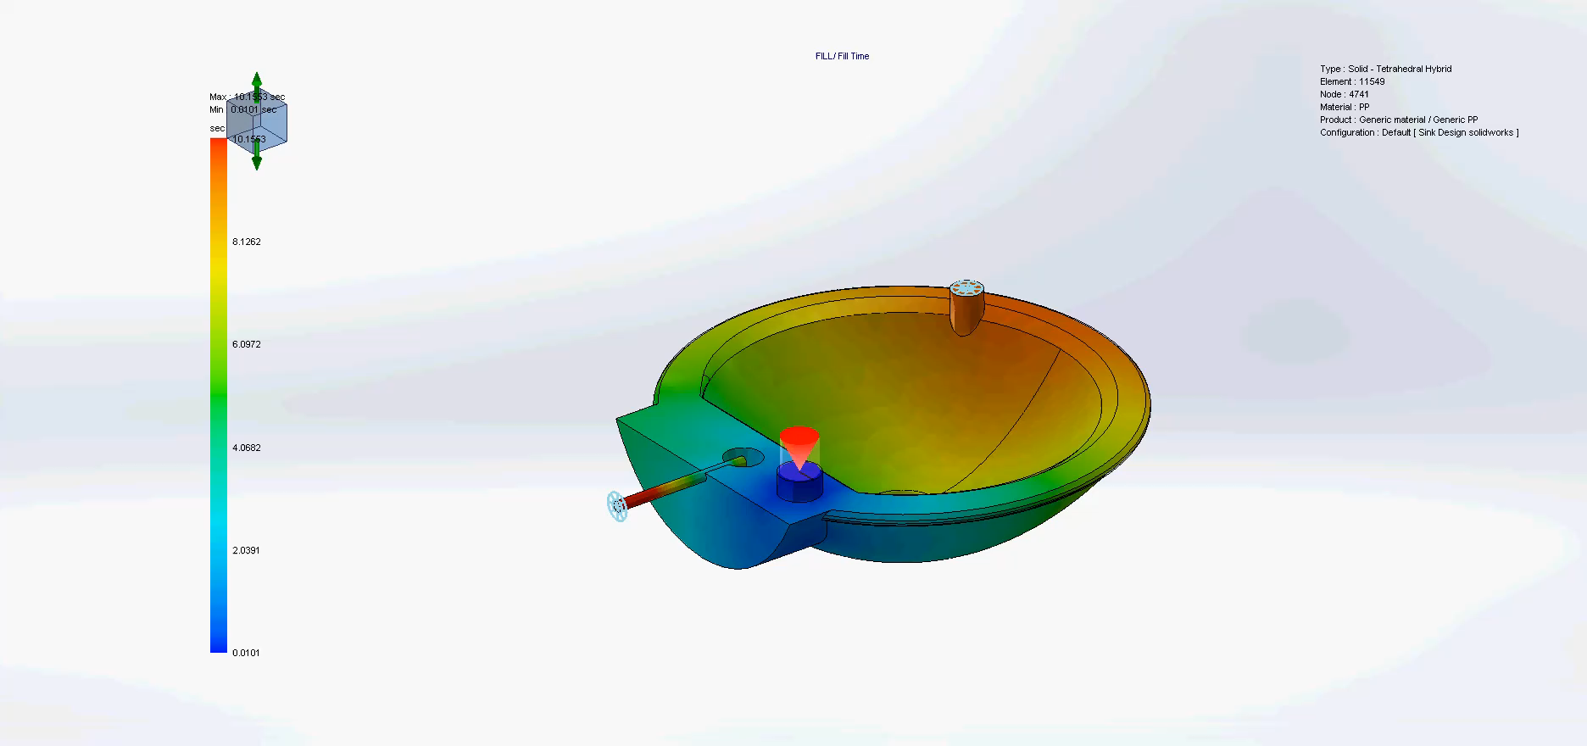
Filling Animation
<Image_Res>

Slide 19
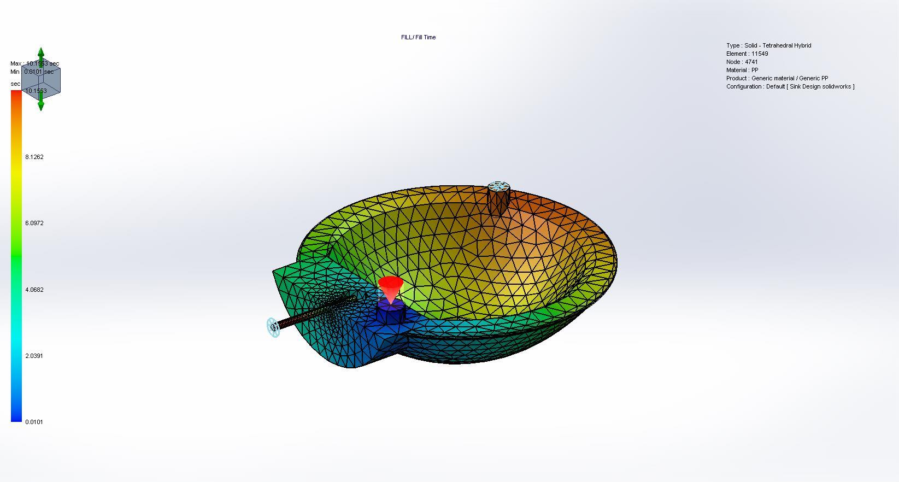
Fill Time
<Image_Res>

Slide 20
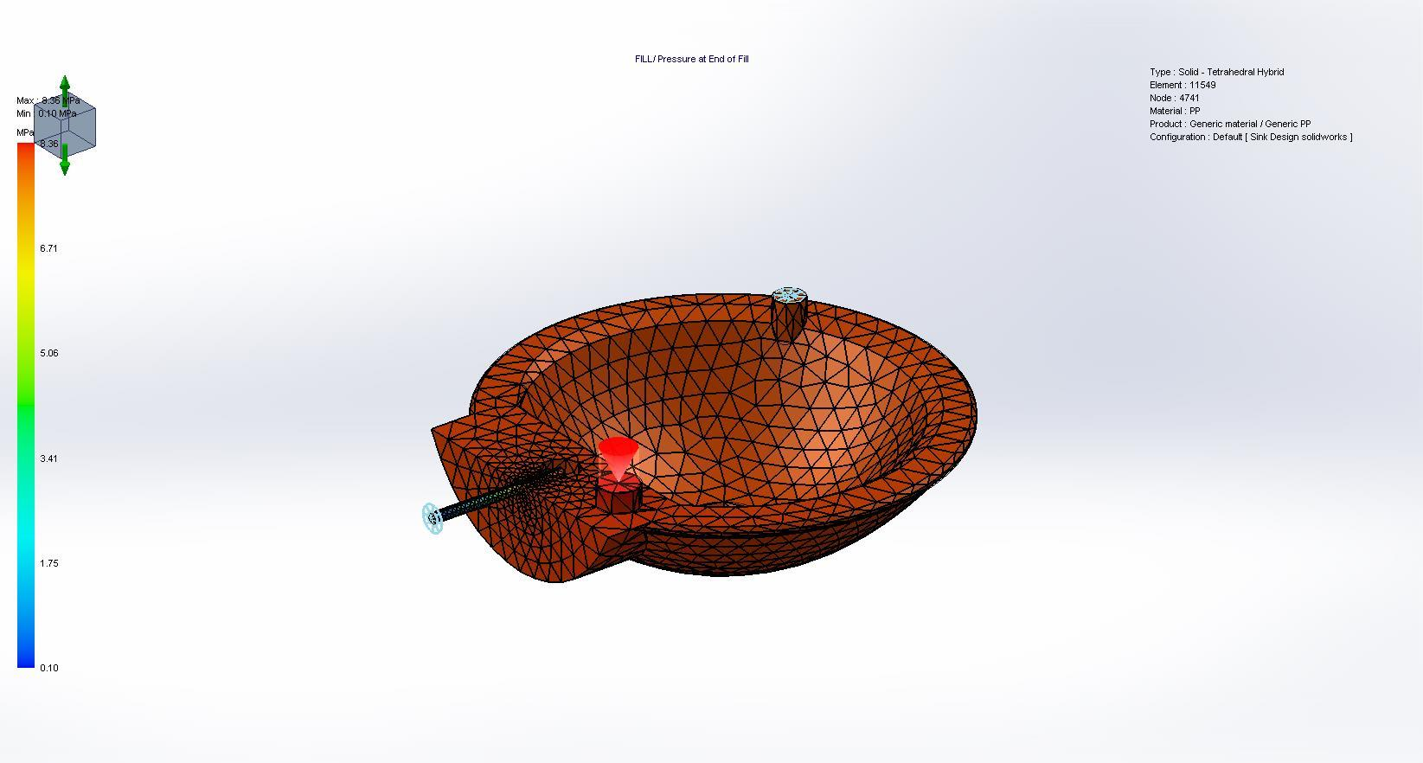
Pressure at End of Fill
<Image_Res>

Slide 21
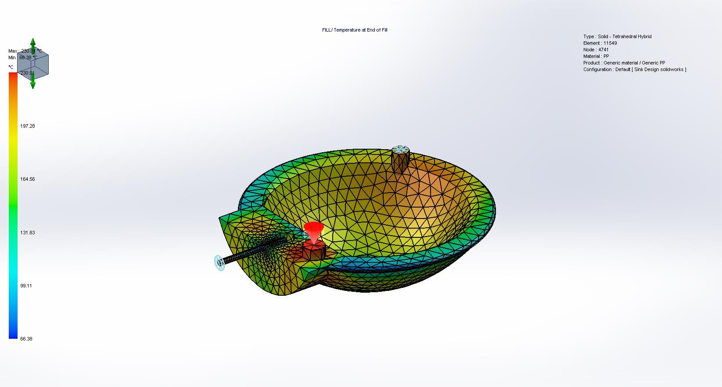
Temperature at End of Fill
<Image_Res>

Slide 22
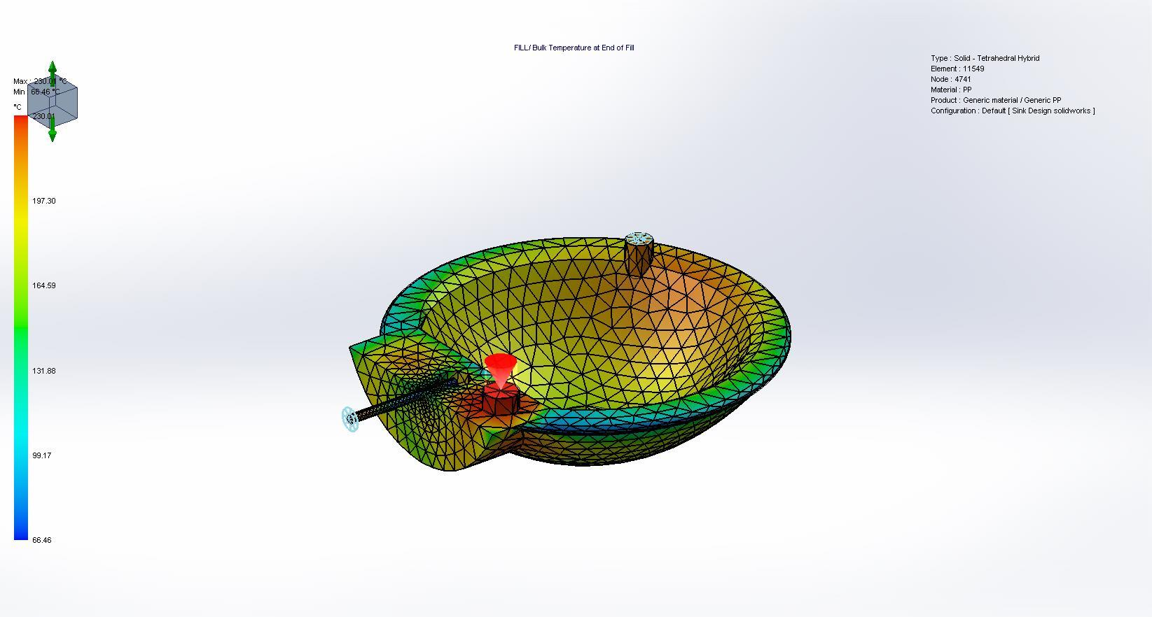
Bulk Temperature at End of Fill
<Image_Res>

Slide 23

Flow Front Temperature
<Image_Res>

Slide 24
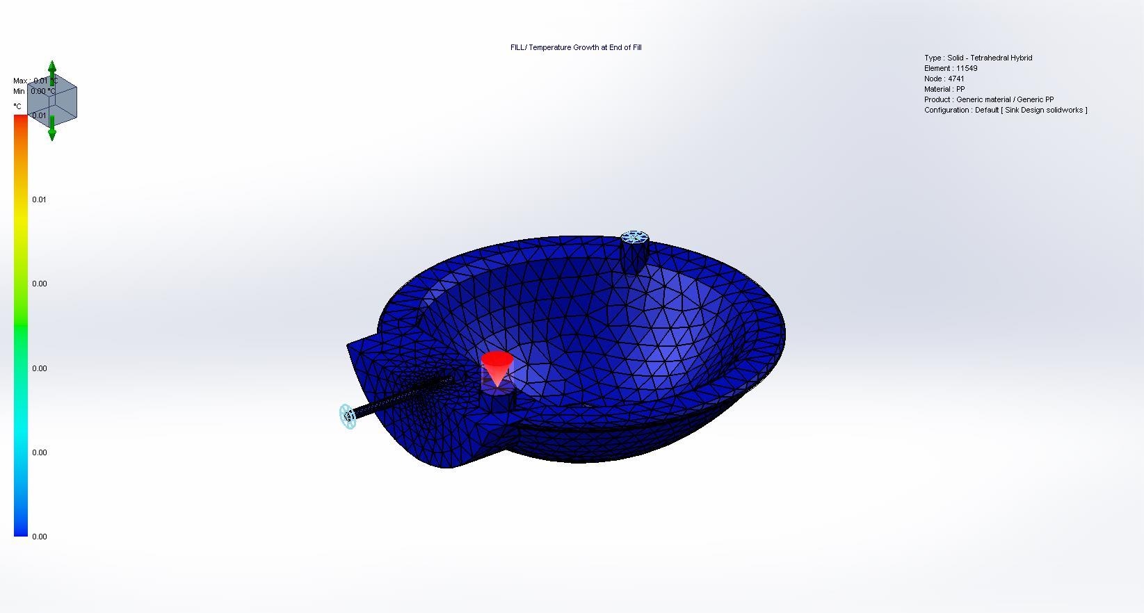
Temperature Growth at End of Fill
<Image_Res>

Slide 25
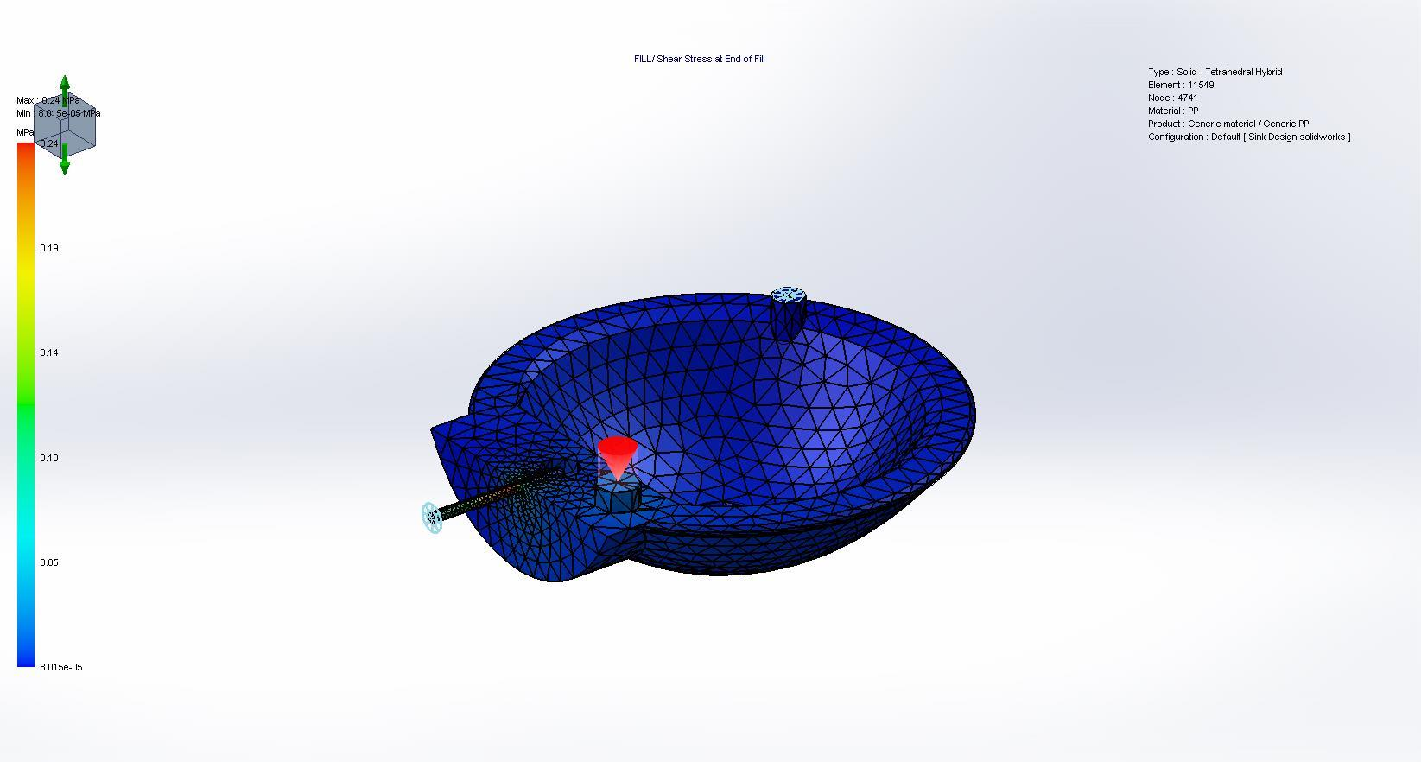
Shear Stress at End of Fill
<Image_Res>

Slide 26

Shear Rate at End of Fill
<Image_Res>

Slide 27
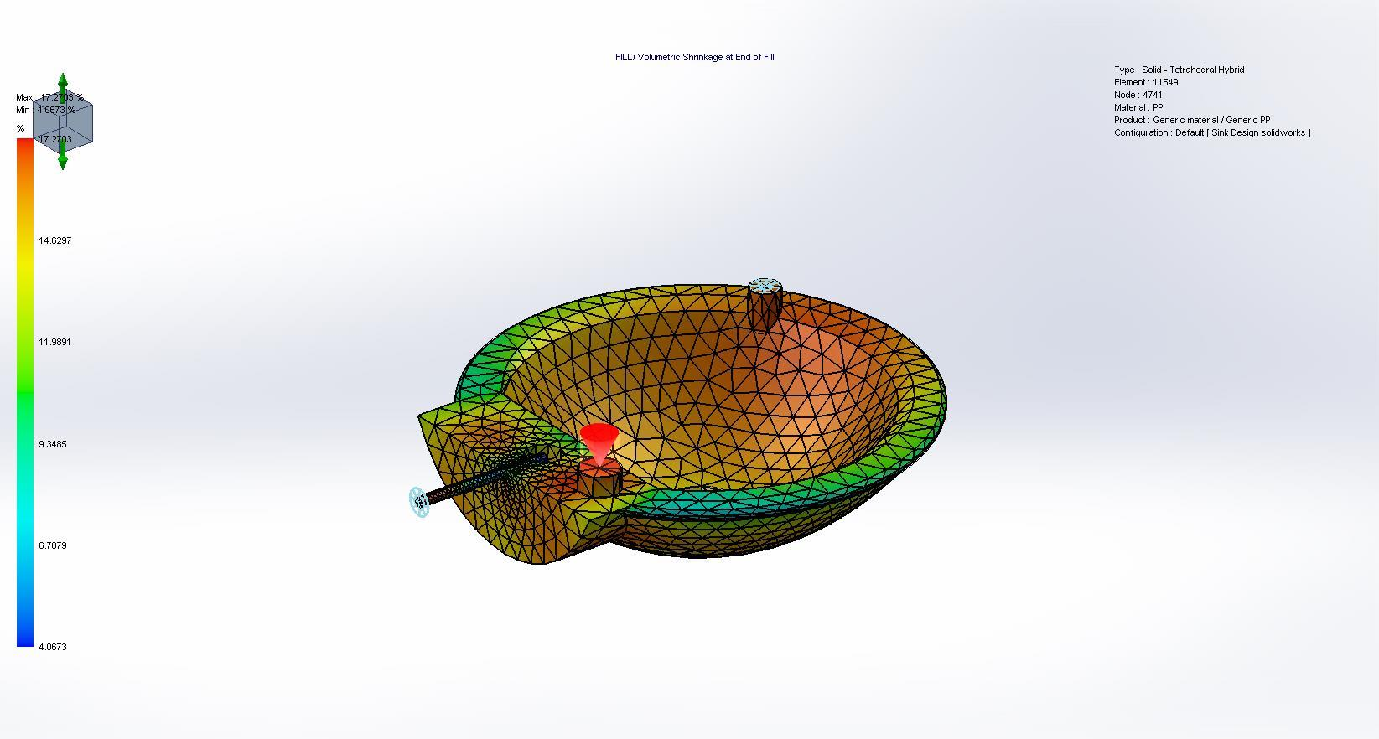
Volumetric Shrinkage at End of Fill
<Image_Res>

Slide 28
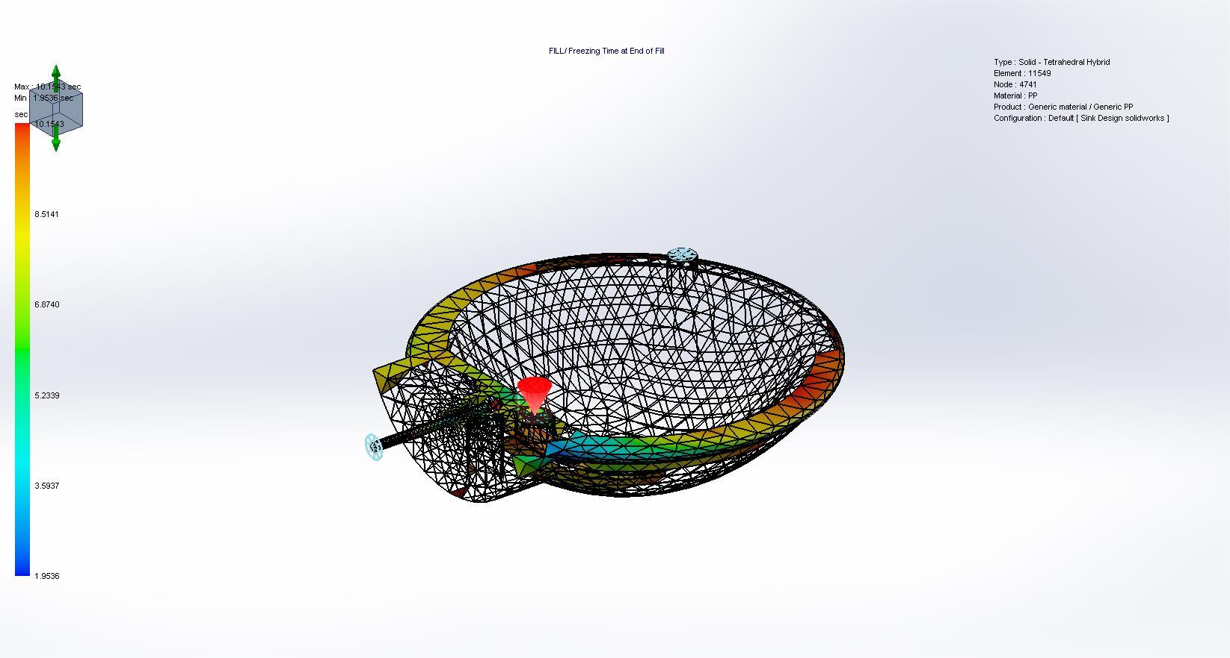
Freezing Time at End of Fill
<Image_Res>

Slide 29
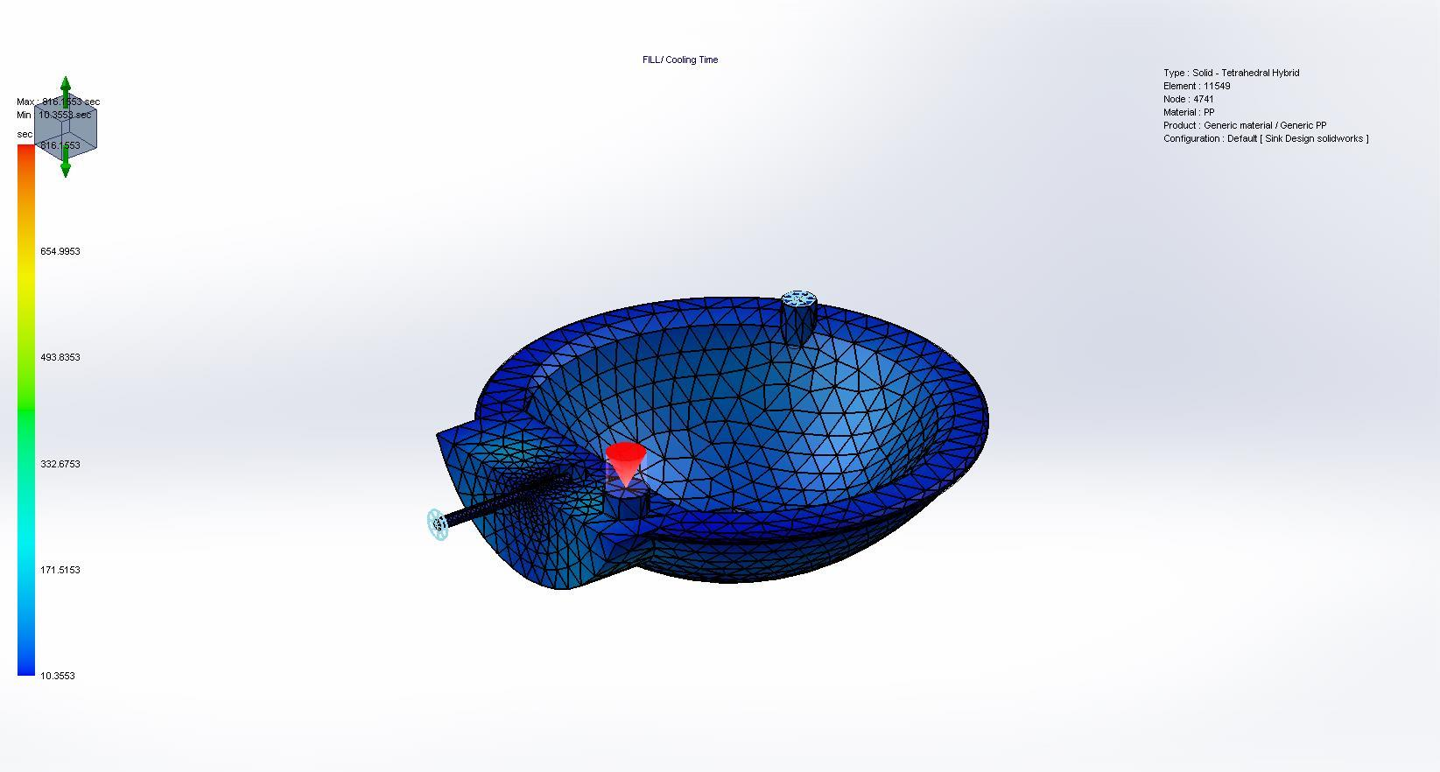
Cooling Time
<Image_Res>

Slide 30
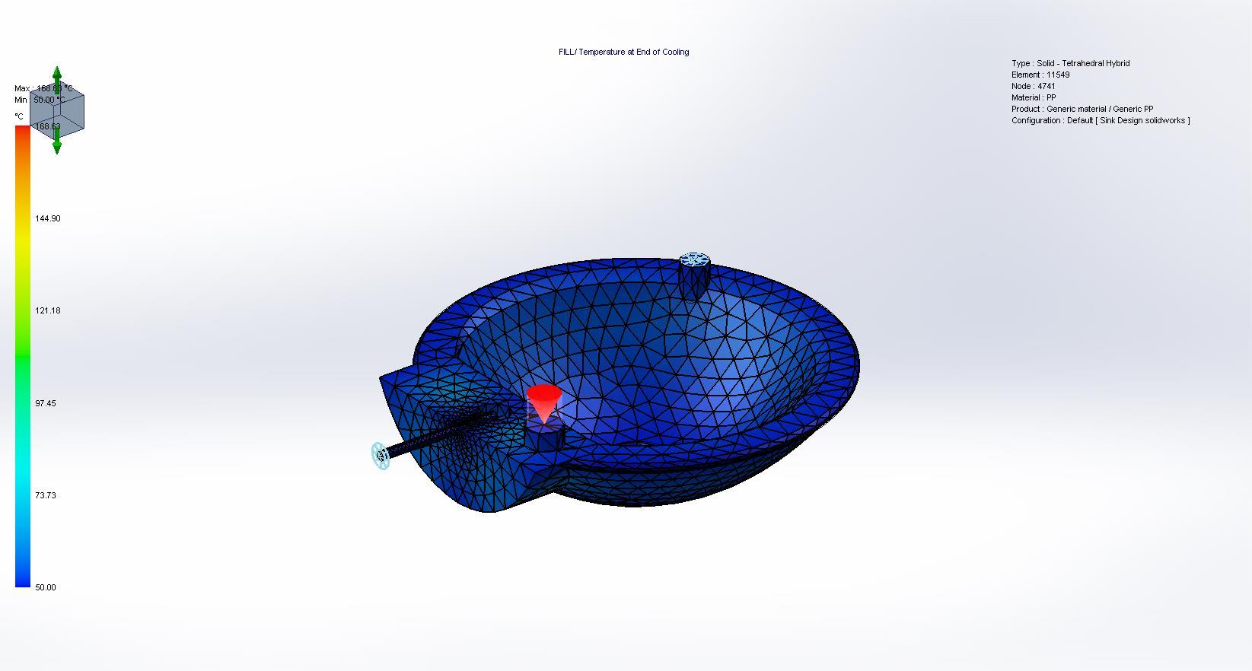
Temperature at End of Cooling
<Image_Res>

Slide 31
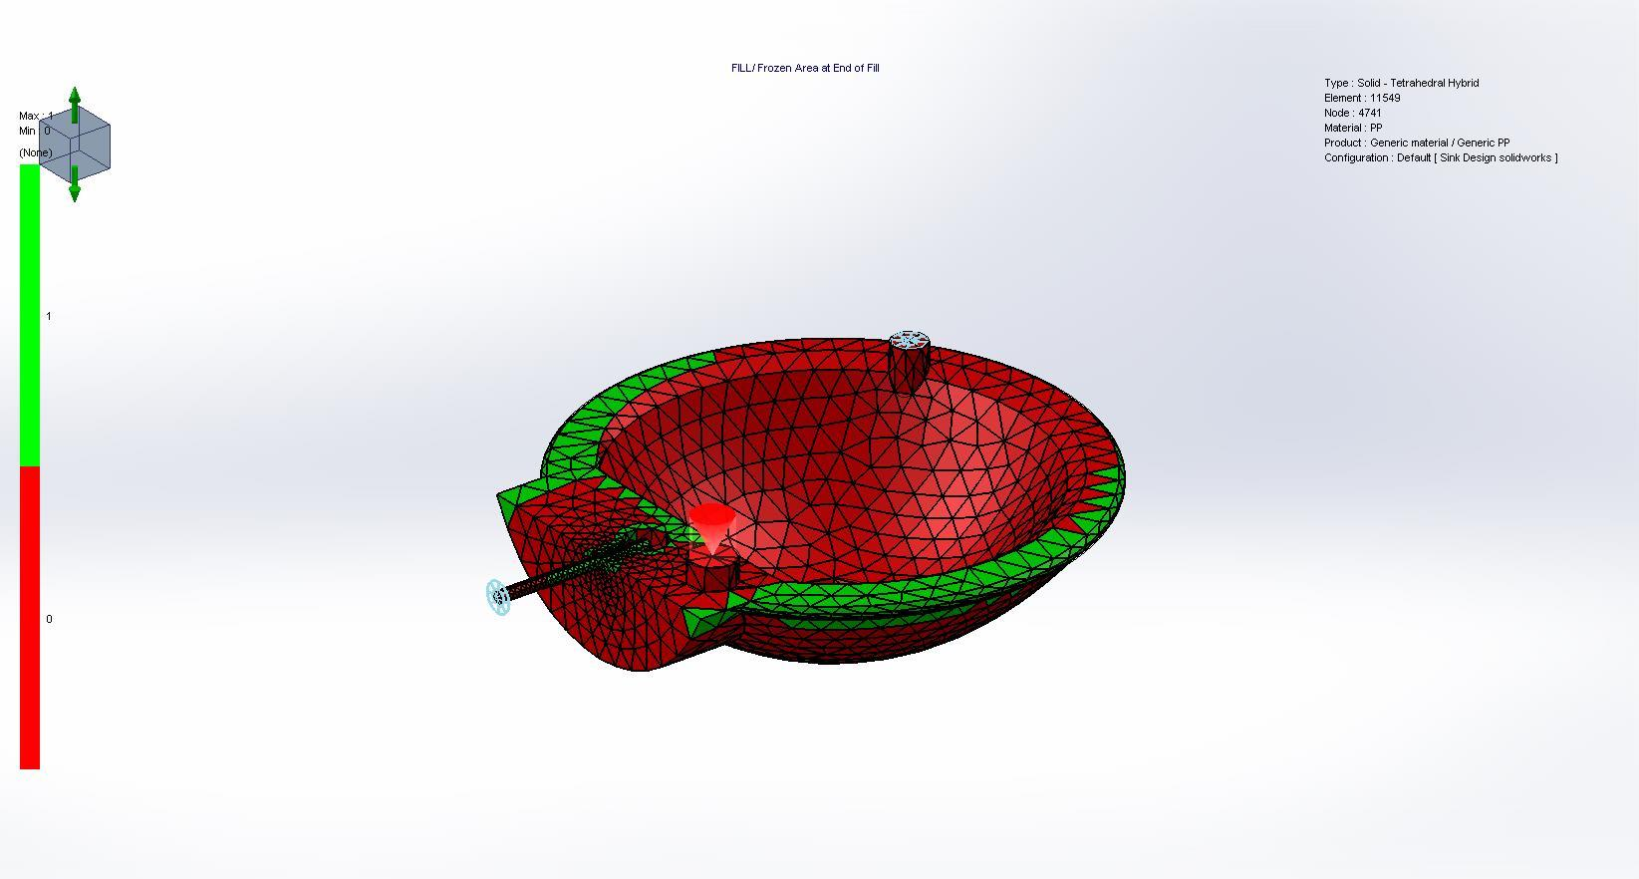
Frozen Area at End of Fill
<Image_Res>

Slide 32
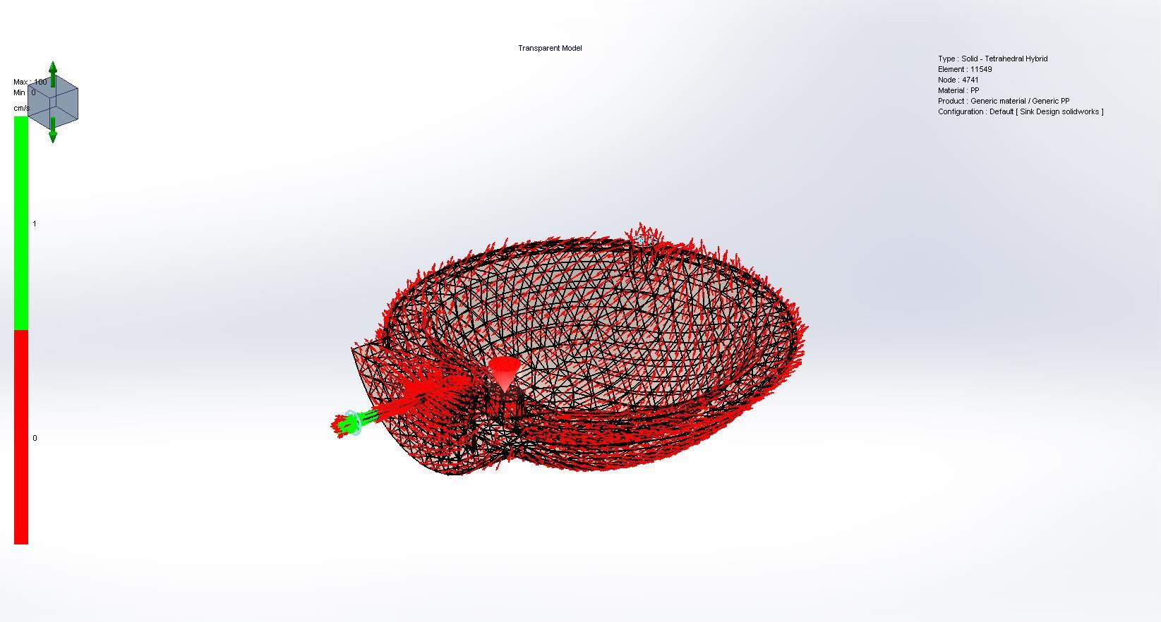
Velocity Vector at End of Fill
<Image_Res>

Slide 33
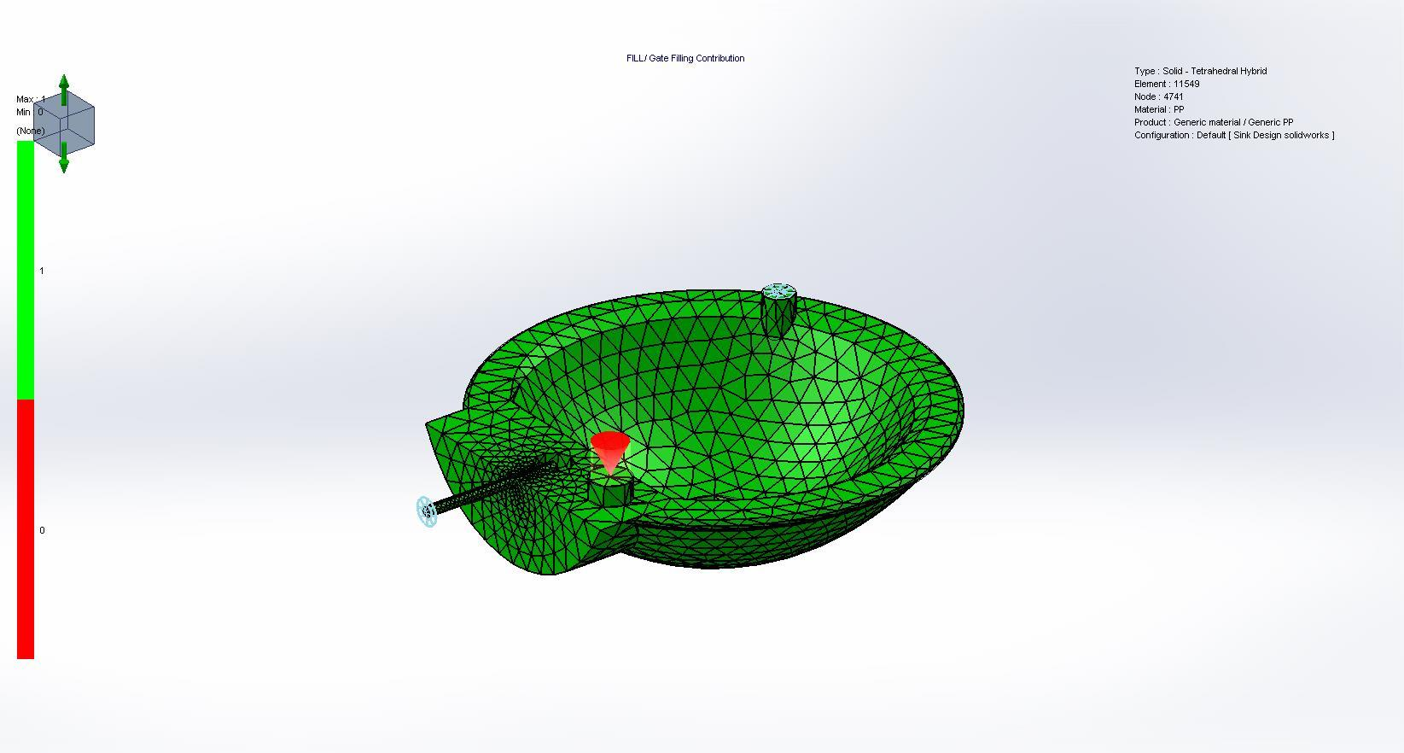
Gate Filling Contribution
<Image_Res>

Slide 34
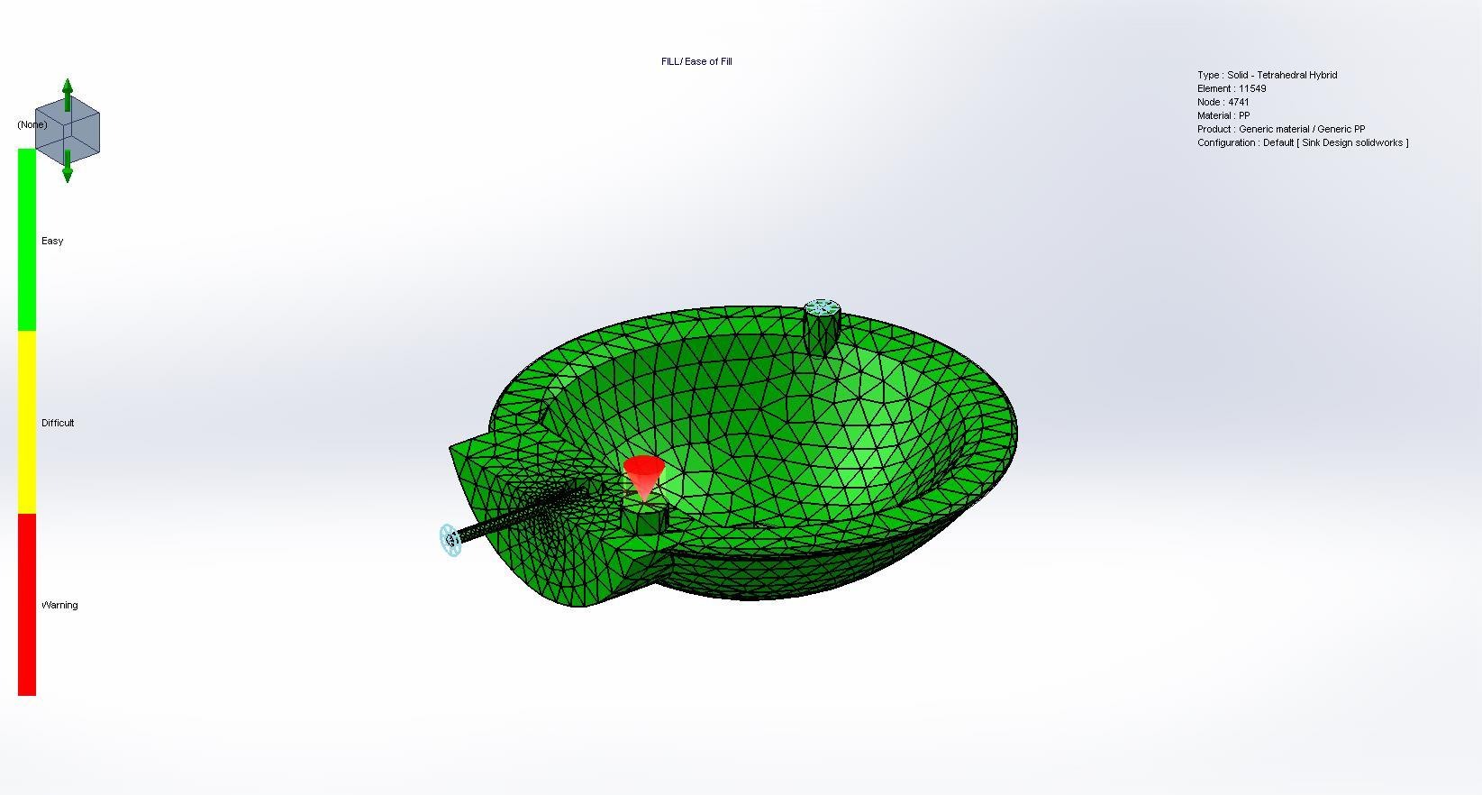
Ease of Fill
<Image_Res>

Slide 35
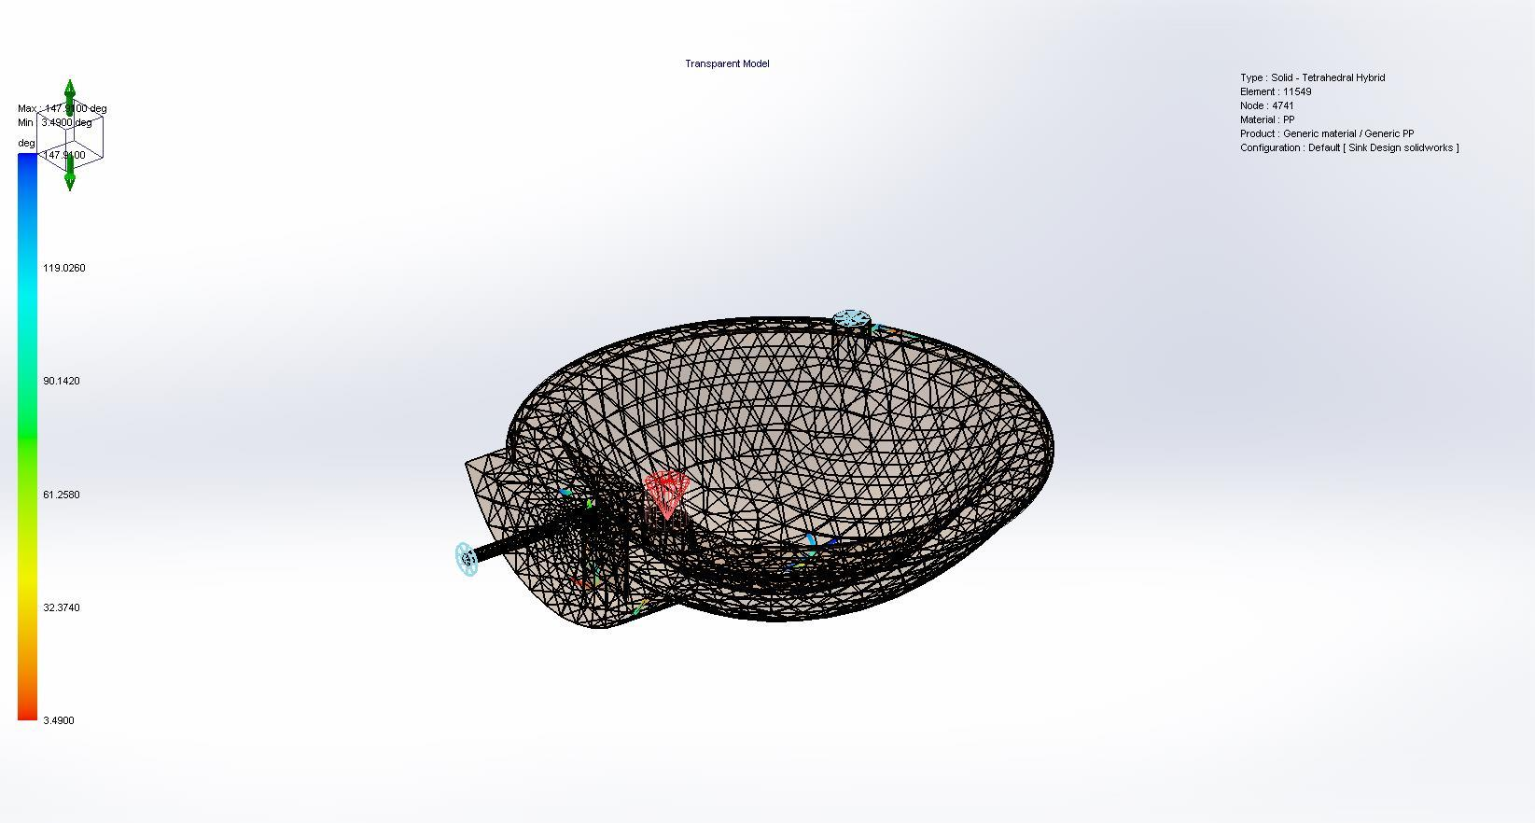
Weld Lines
<Image_Res>

Slide 36

Air Traps
<Image_Res>

Slide 37
Results Summary
Pack Results
<Results_Summary/>
Clamp Force | 29.5291 Tonne
X-dir. Clamping Force | 14.3119 Tonne
Y-dir. Clamping Force | 29.5291 Tonne
Z-dir. Clamping Force | 14.7500 Tonne
Max. real temperature | 229.3655 °C
Max. bulk temperature | 230.0257 °C
Max. shear stress | 0.3484 Mpa
Max. shear rate | 0.3235 1/sec
Max. residual stress | 59.1820 Mpa
Mass at the end of packing | 502.88 (g)

Slide 38
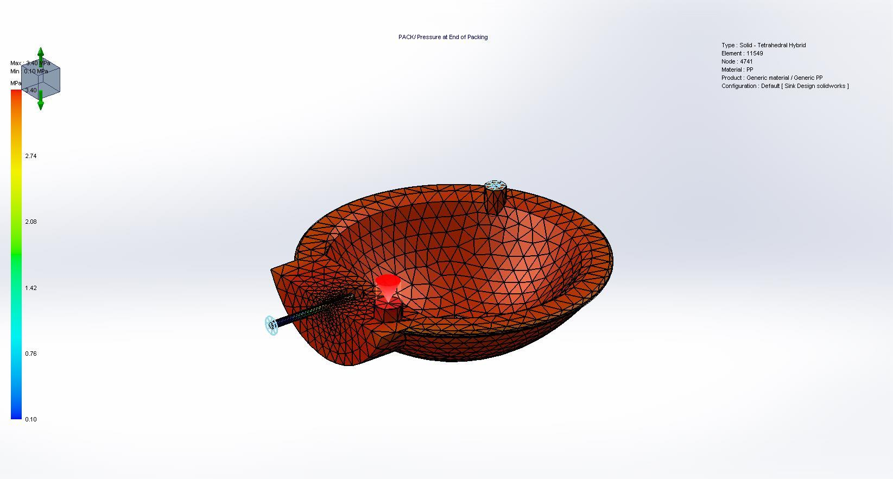
Pressure at End of Packing
<Image_Res>

Slide 39
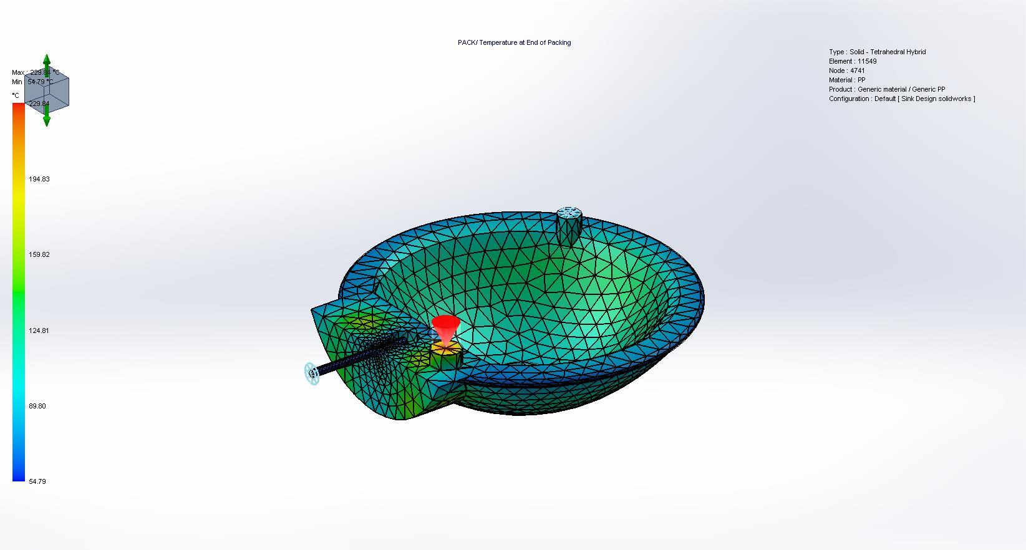
Temperature at End of Packing
<Image_Res>

Slide 40

Bulk Temperature at End of Packing
<Image_Res>

Slide 41
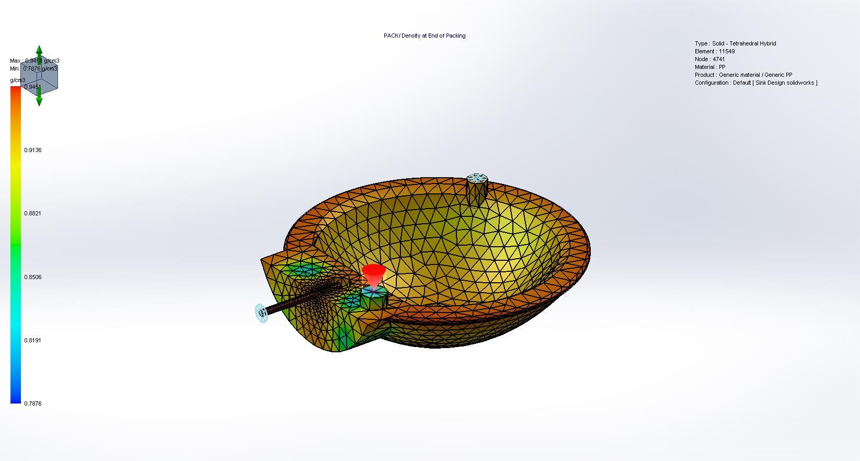
Density at End of Packing
<Image_Res>

Slide 42

Shear Stress at End of Packing
<Image_Res>

Slide 43
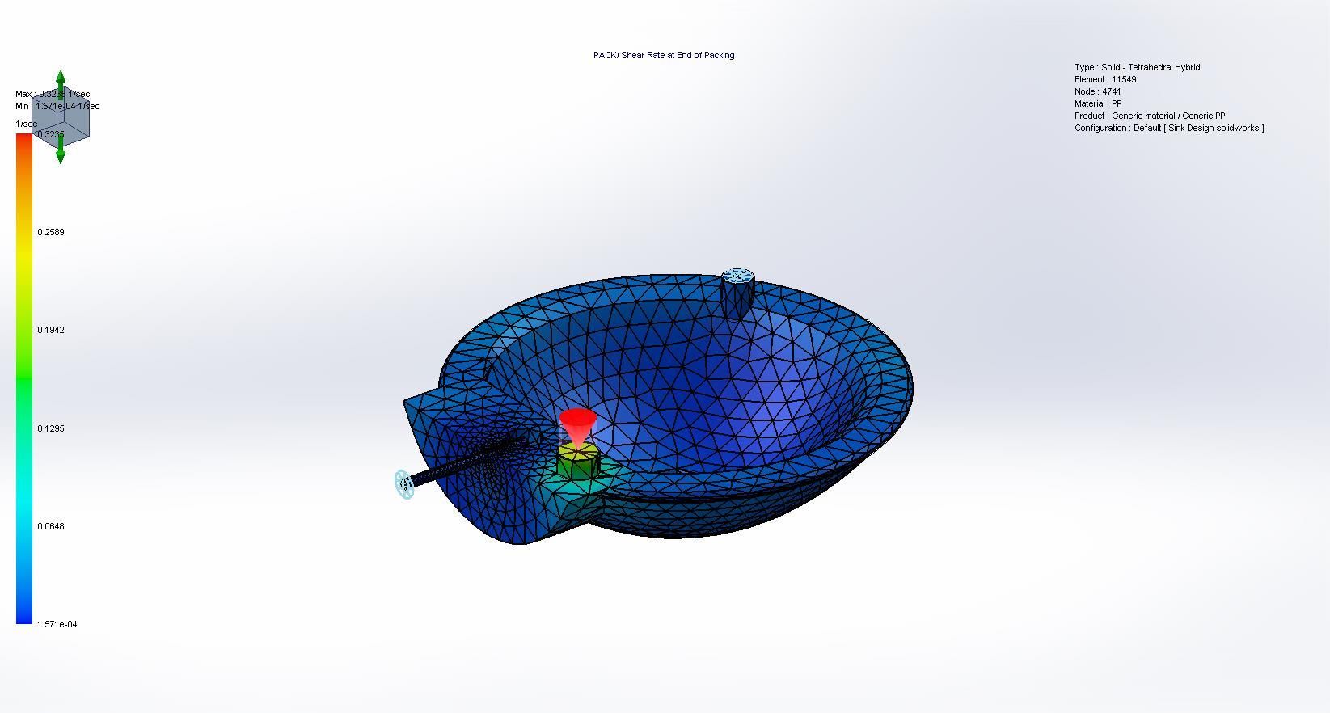
Shear Rate at End of Packing
<Image_Res>

Slide 44
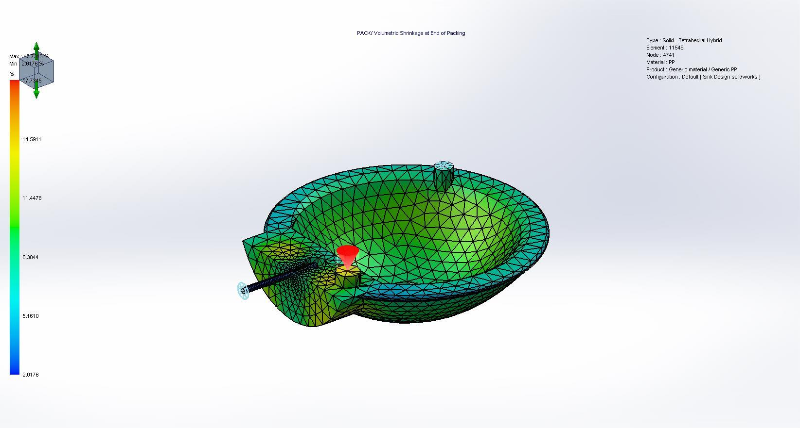
Volumetric Shrinkage at End of Packing
<Image_Res>

Slide 45

Temperature at Post-Filling End
<Image_Res>

Slide 46
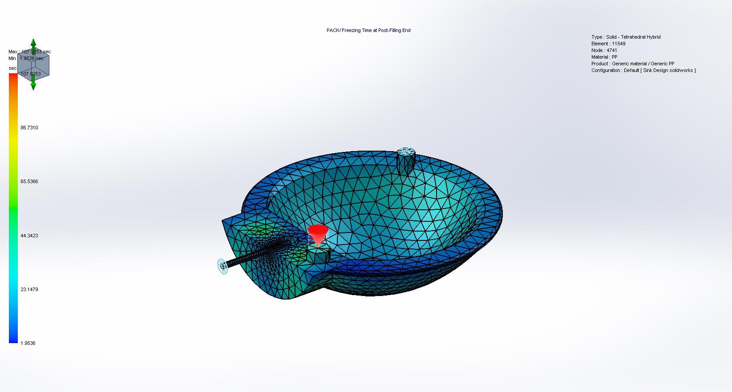
Freezing Time at Post-Filling End
<Image_Res>

Slide 47
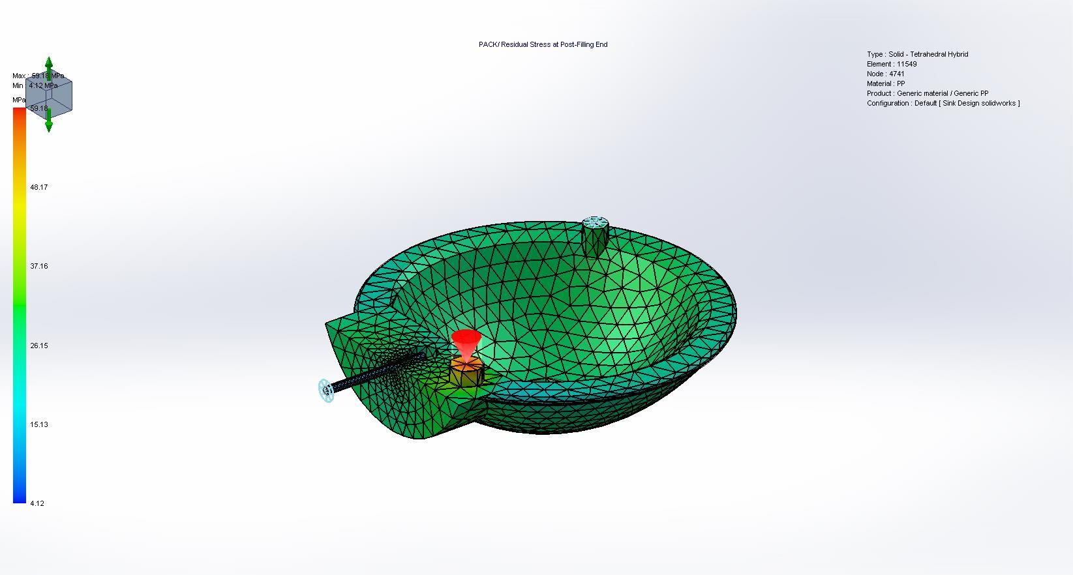
Residual Stress at Post-Filling End
<Image_Res>

Slide 48
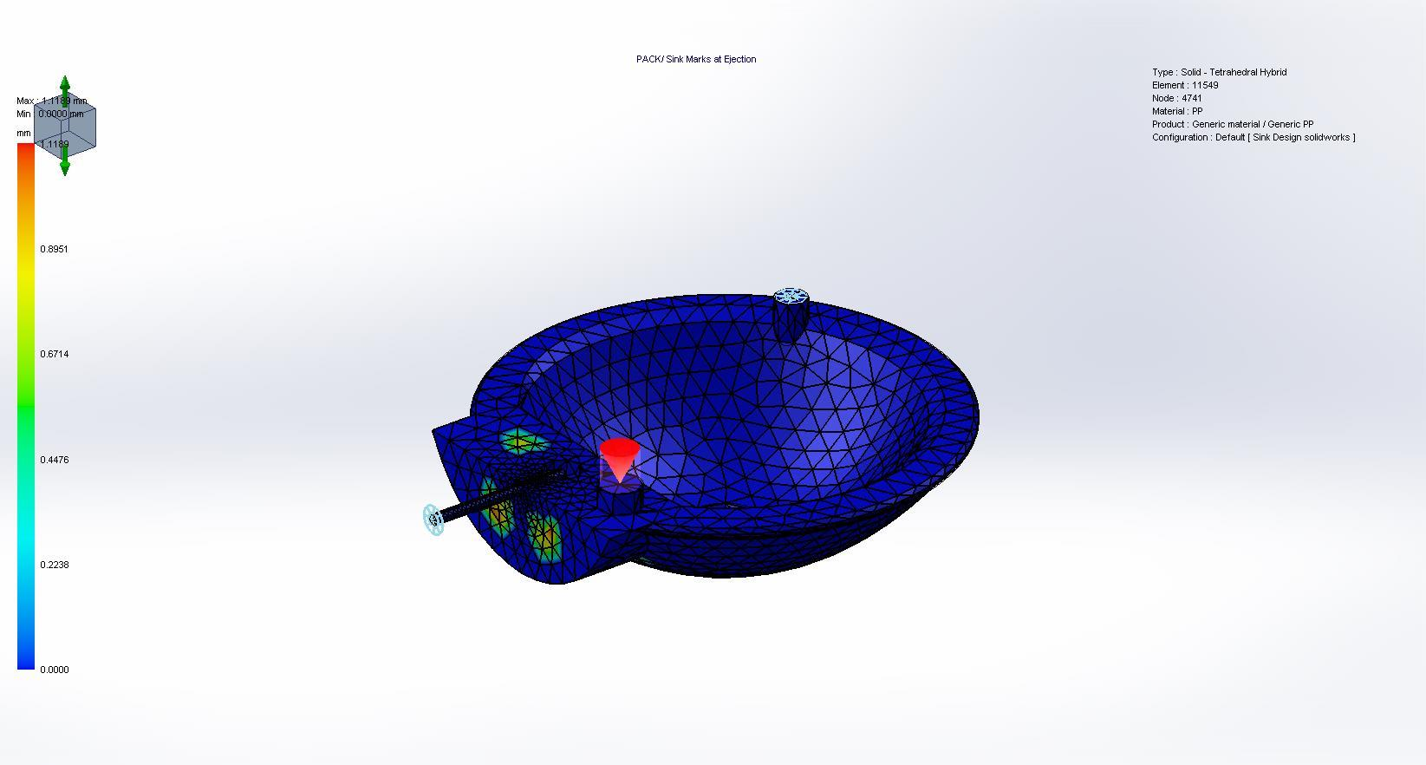
Sink Marks at Ejection
<Image_Res>

Slide 49

Frozen Area at Post-Filling End
<Image_Res>

Slide 50
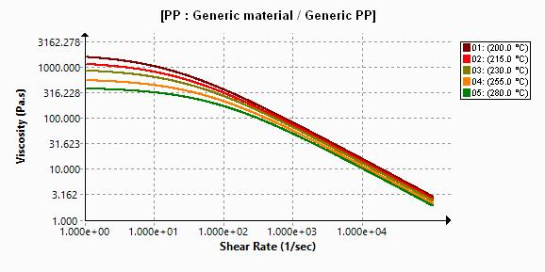
X-Y Plot
Material Parameter
<Image_Res>

Slide 51
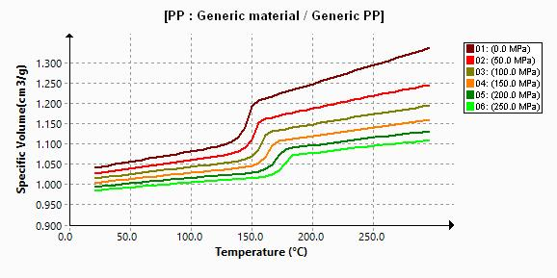
X-Y Plot
Material Parameter
<Image_Res>

Slide 52
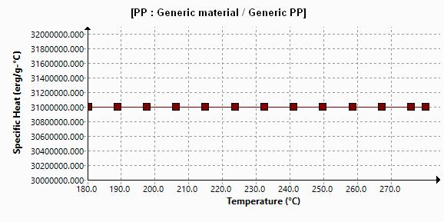
X-Y Plot
Material Parameter
<Image_Res>

Slide 53
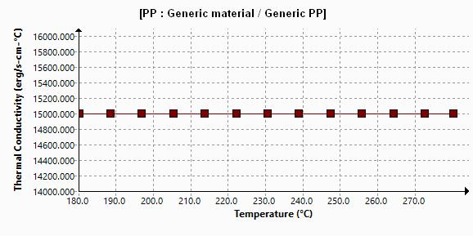
X-Y Plot
Material Parameter
<Image_Res>

Slide 54
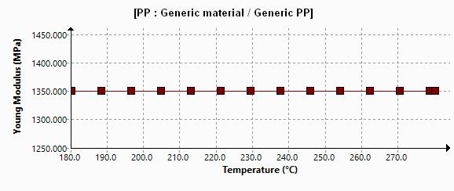
X-Y Plot
Material Parameter
<Image_Res>

Slide 55
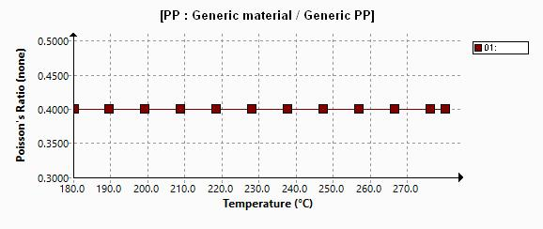
X-Y Plot
Material Parameter
<Image_Res>

Slide 56
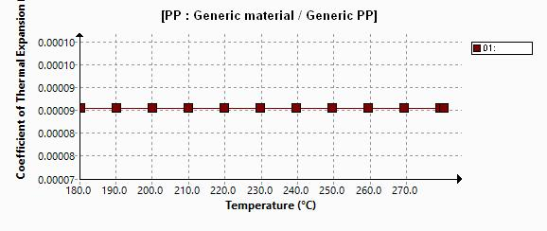
X-Y Plot
Material Parameter
<Image_Res>

Slide 57
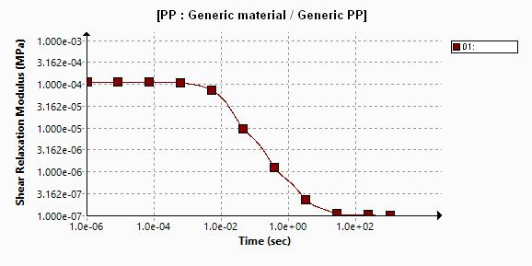
X-Y Plot
Material Parameter
<Image_Res>

Slide 58
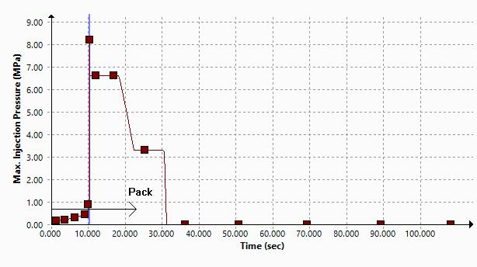
X-Y Plot
Max. Injection Pressure
<Image_Res>

Slide 59
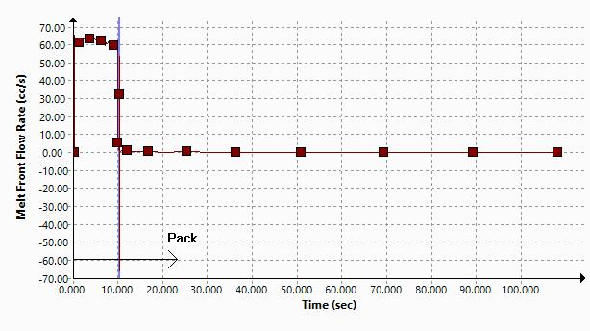
X-Y Plot
Melt Front Flow Rate
<Image_Res>

Slide 60
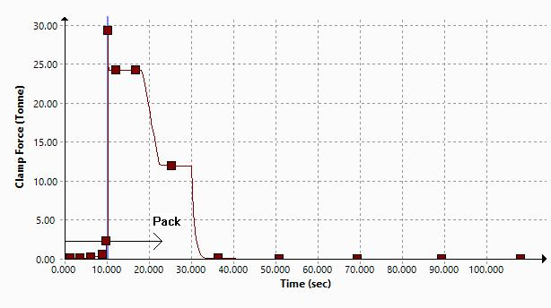
X-Y Plot
Clamp Force
<Image_Res>

Slide 61
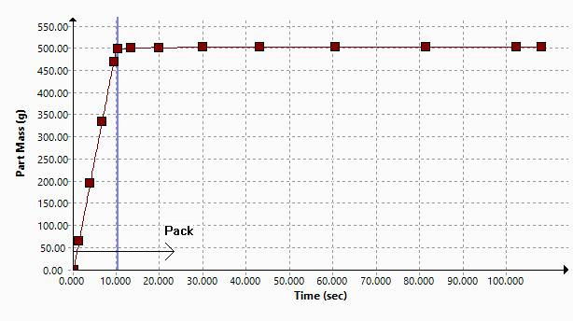
X-Y Plot
Part Mass
<Image_Res>

Slide 62
Conclusion

